Slide 1

TEAM MEMBERS:
E.G.PRADEEP
M.S.SAI SANKEET
B.PRASANTH
DEP:B.TECH.ECE

Slide 2
SUBJECT NAME:SMART SENSORS AND DEVICES FOR AGRICULTURE
SUBJECT CODE:21ECE203J

Slide 3
MINI PROJECT:WATER LEVEL INDICATOR
SUSTAINABLE DEVELOPMENT GOAL

Slide 4
COMPONENTS REQUIRED:
~9V BATTERY
~connecting wires
~ON/OFF SWITCH
~BUZER ALARM
~METAL SHEET

Slide 5
USES: A water level indicator in agriculture is a crucial tool for efficient water management. It helps farmers and agricultural practitioners monitor and control the water levels in various irrigation systems. Here are some specific uses of water level indicators in agriculture:
1.Optimizing Irrigation:
Water level indicators assist farmers in determining the water depth in the soil. This information helps optimize irrigation schedules by ensuring that crops receive the appropriate amount of water.
Farmers can avoid overwatering or underwatering, which is essential for crop health and growth.
2.Preventing Waterlogging:
~Waterlogging can occur when the soil is oversaturated with water. A water level indicator helps farmers monitor the soil moisture content and prevents waterlogging, which can be detrimental to plant roots and overall crop health.
3.Conserving Water Resources:
~By providing real-time information on soil moisture levels, water level indicators help farmers use water more efficiently. This can lead to water conservation, an important aspect in regions facing water scarcity or where sustainable water use is a concern.
4.Energy Efficiency:
~Proper water management, facilitated by water level indicators, contributes to energy efficiency. Unnecessary pumping and distribution of excess water can be avoided, leading to energy savings in irrigation systems.
5.Reducing Costs:
~Efficient water management through water level indicators can lead to cost savings. Farmers can avoid unnecessary water expenses and potential damage to crops caused by either inadequate or excessive irrigation.

Slide 6
APPLICATIONS:
1.Irrigation Management:
Monitoring soil moisture levels helps farmers determine when and how much water to apply to crops. This ensures optimal irrigation and prevents both overwatering and underwatering.
2.Drip Irrigation Systems:
Water level indicators can be integrated into drip irrigation systems to precisely control the release of water. This promotes water conservation and ensures that plants receive the right amount of moisture directly at their roots.
3.Sprinkler Systems:
In sprinkler irrigation, water level indicators can be used to control the timing and duration of irrigation cycles, preventing water wastage and ensuring even water distribution across the field.
4.Greenhouse Cultivation:
Water level indicators are essential in greenhouse farming to maintain optimal soil moisture for specific crops. They enable automated irrigation systems to respond to the changing needs of plants in a controlled environment.
5.Soil Moisture Monitoring:
Continuous monitoring of soil moisture levels using water level indicators helps farmers assess the water-holding capacity of the soil. This information guides irrigation practices and aids in making informed decisions about water application.

Slide 7
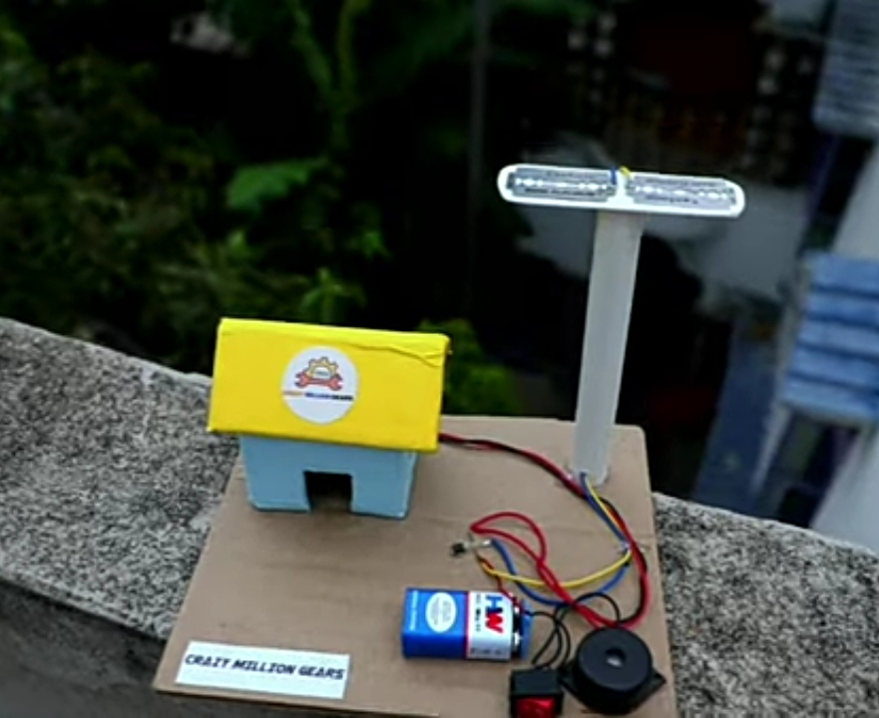
FINAL PROJECT :

Slide 8
THANK YOU

